Slide 1
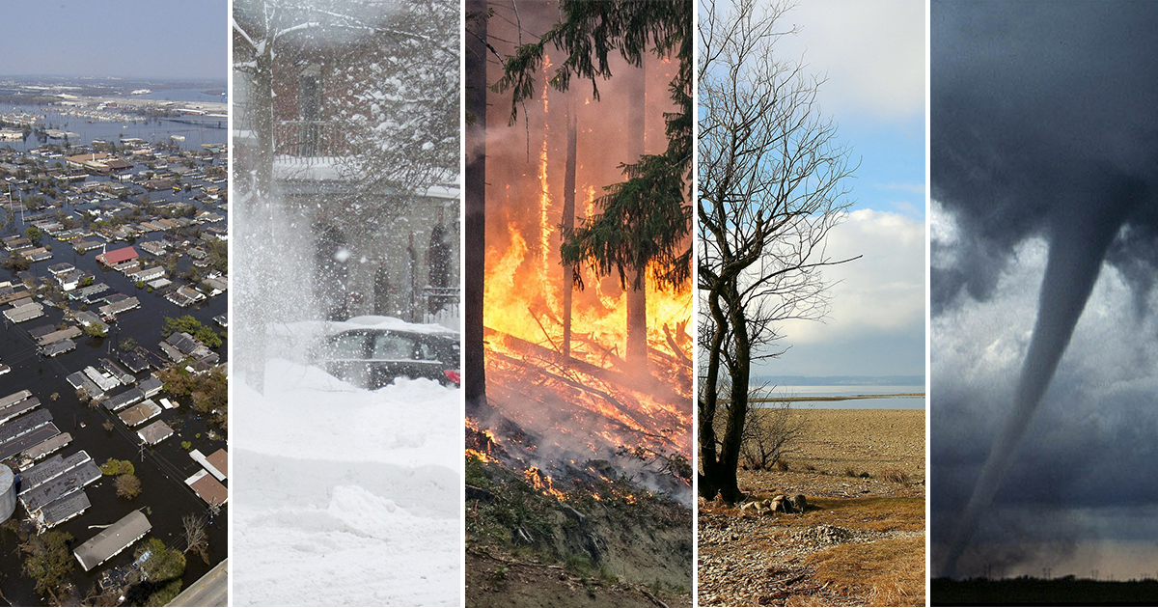

The Impact of Climate Change on Global Economies Worldwide Report
Octavian Badea

Slide 2
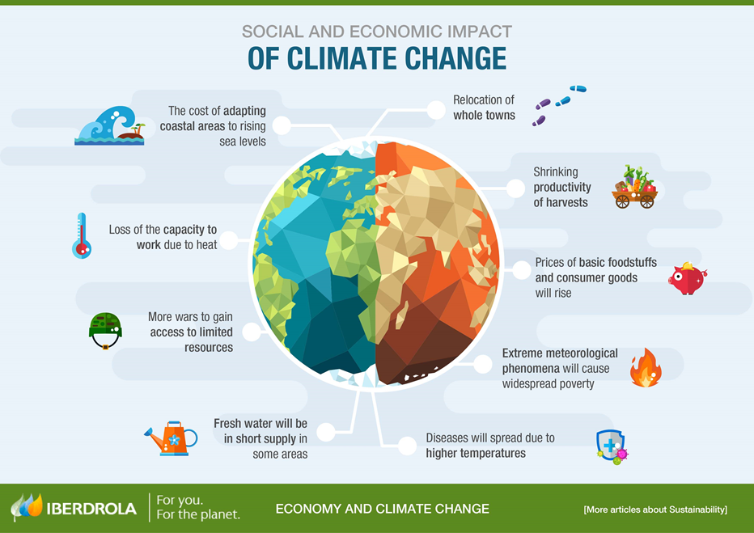
Introduction to The Impact of Climate Change on Global Economies Worldwide Report
Climate change impacts humanity every years. It can cause a lot of disasters that can affect anyone. The effects of climate change in the past decades has affected life differently. Temperatures have risen highly over the years. Therefore, the impact of climate change is really concerning because it affects everyone not just global economies. Temperatures in Edmonton used to be -30°C in the winter. Now the temperature in the winter is not colder then -10°C in the same city. Summers in the city were not warmer then 25°C. Now summers in Edmonton can be as warm as 30°C. Spring in Romania, used to be no warmer then 20°C. Now Spring in the same country is 30°C.

Slide 3
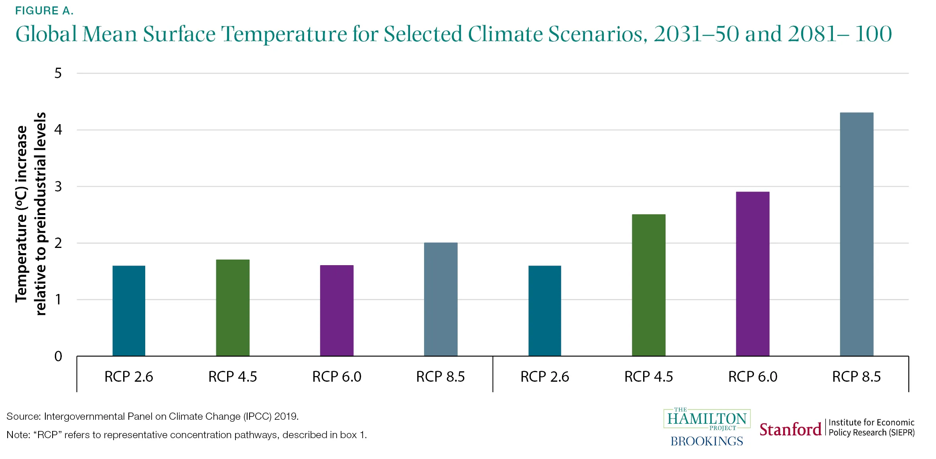
Macroeconomic forecasting and monetary policy
The physical risks of climate change will likely imply increases in the frequency and severity of negative supply shocks (e.g., destruction of capital stocks, disruptions to labour supply, disruptions to supply chains) and demand shocks (e.g., damage to household and corporate balance sheets that result in reduced consumption and investment). While demand shocks are typically manageable from a monetary policy perspective, supply shocks are generally more challenging because they generate a trade-off for central banks between stabilizing inflation and stabilizing output variations . There is a high degree of uncertainty regarding the future path of climate change, climate policies, technological innovation and socio-economic changes. Climate-economy models must therefore be used to develop a range of plausible macro financial scenarios to assess possible outcomes.

Slide 4
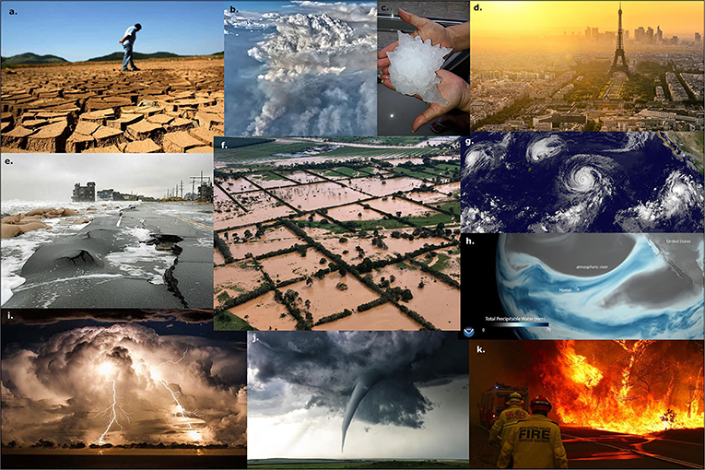
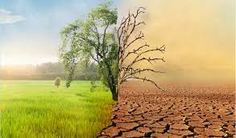
Assessing climate-related risks to the financial system
Extreme weather events could cause damage to physical assets, including real estate, capital and infrastructure, and loss of life with consequent property and casualty (P&C) insurance losses, damage to balance sheets of both households and firms, increases in defaults, and potential financial sector distress.
More frequent or severe extreme weather events and/or a late and abrupt transition to a low-carbon economy could have significant impacts on the Canadian financial system, with potential systemic consequences.
A late and abrupt transition to a low-carbon economy could lead to a sudden repricing of climate-related risks and stranded assets, which could negatively affect the balance sheets of financial market participants, with potential consequences to financial stability. Given the Canadian economy’s reliance on carbon-intensive activities, its financial system could be particularly vulnerable to transition risks under some adverse scenarios.

Slide 5
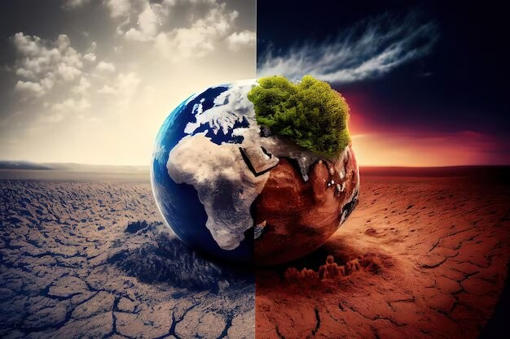
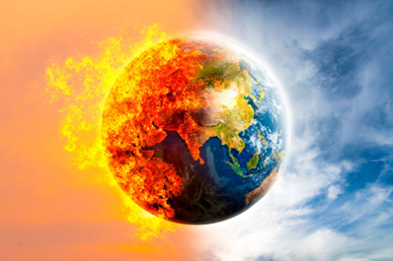
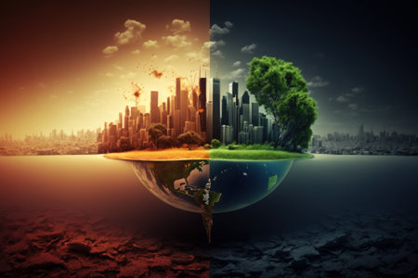
The economic response to climate change
There is no single pathway to achieving climate targets.
A whole systems approach to carbon elimination is needed if we are to limit the climate extremes that cause such damage to human wellbeing, the economy and the environment.
While we don’t know what the low-carbon transition will cost, as it depends on the choices and investments we make today and in the future, the longer we wait to manage that change, the higher the costs and the graver the environmental risks.
Most progress towards a low-carbon economy to date has been thanks to decreases in coal from energy production, and the final pact agreed at COP26 should ensure even greater reductions. The International Energy Agency estimates that ‘Renewables will overtake coal to become the largest source of electricity generation worldwide in 2025’, and the world now invests more in renewable power generation (excluding nuclear and hydro) than in oil, gas and coal generation combined (see Figure 4).

Slide 6
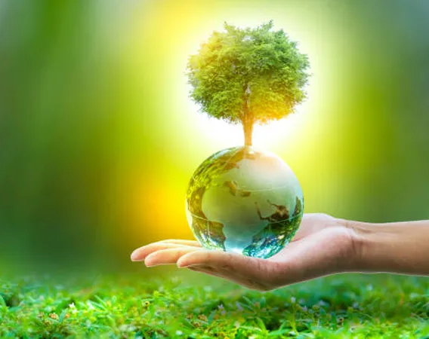
Investing in green innovation
One route of many towards a low-carbon future is investment in green technologies. Greener energy production may be the success story of climate change mitigation efforts so far, but there is still plenty more innovation to be achieved in the sector that could bring further benefits.
A wide range of energy technologies can bring us closer to net zero, and could also help to decarbonise the vehicle sector. Promising developments that may benefit from continued savings in research efforts include:
• Nanotechnology-based supercapacitors – energy storage devices with graphene nanotube electrodes could offer superior performance to batteries in powering electric cars, and potentially even aircraft and trains.
• Small modular nuclear reactors, based on the well-developed nuclear-powered engines in submarines.
• Vehicle-to-grid (V2G) systems – whereby the nation’s electric cars are networked to form a vast electric storage system, akin to the National Grid’s storage.
While many responses to climate change lie in technology, the right economic conditions are needed to develop greener technologies and for these to thrive commercially. Technological innovation creates a virtuous cycle that outgrowths economies of scale in manufacture and discovery. As solutions are brought closer to reality and become cheaper to develop and apply, there is more incentive for deployment.

Slide 7

Conclusions
Using the results from formal economic models, the Review estimates that if we don't act, the overall costs and risks of climate change will be equivalent to losing at least 5% of global GDP each year, now and forever.
If we do not take action now, our world will undergo drastic changes that will negatively affect our environment for thousands of years.

Slide 8
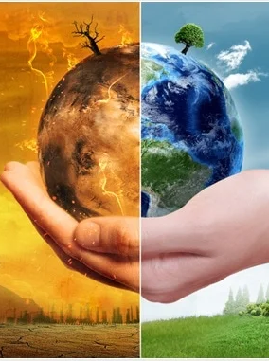
Where can I find out more?
https://www.bankofcanada.ca/2019/11/researching-economic-impacts-climate-change/
https://www.economicsobservatory.com/climate-change-what-are-the-economic-impacts-and-potential-solutions
BBC: Six graphics that explain climate change
Measuring the real-world costs of climate change: Climate Impact Lab
Global Warming of 1.5°C: Summary for policy-makers of the IPCC’s 2018 Special Report on the impacts of global warming of 1.5°C above pre-industrial levels and related global greenhouse gas emission pathways, in the context of strengthening the global response to the threat of climate change

Slide 9
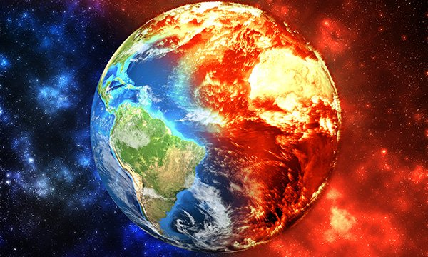
References
Battiston, S., A. Mandel, I. Monasterolo, F. Schütze and G. Visentin. 2017. “A Climate Stress-Test of the Financial System.” Nature Climate Change 7: 283–288.
Dietz, S. and N. Stern. 2015. “Endogenous Growth, Convexity of Damages and Climate Risk: How Nordhaus’ Framework Supports Deep Cuts in Carbon Emissions.” Economic Journal 125 (583): 574–620.
Gillingham, K., W. Nordhaus, D. Anthoff, G. Blanford, V. Bosetti, P. Christensen, H. McJeon, J. Reilly and P. Sztorc. 2015. “Modeling Uncertainty in Climate Change: A Multi-Model Comparison.” Cowles Foundation Discussion Paper No. 2022.

